Slide 1
OPERATING SYSTEMS
STRUCTURES
Jerry Breecher

Slide 2
OPERATING SYSTEM Structures
What Is In This Chapter?
System Components
System Calls
How Components Fit Together
Virtual Machine

Slide 3
OPERATING SYSTEM STRUCTURES
SYSTEM COMPONENTS
These are the pieces of the system we’ll be looking at:
Process Management
Main Memory Management
File Management
I/O System Management
Secondary Management
Networking
Protection System
Command-Interpreter System

Slide 4
OPERATING SYSTEM STRUCTURES
SYSTEM COMPONENTS
PROCESS MANAGEMENT
  A process is a program in execution: (A program is passive, a process active.)
  A process has resources (CPU time, files) and attributes that must be managed.
  Management of processes includes:
    Process Scheduling (priority, time management, . . . )
    Creation/termination
    Block/Unblock (suspension/resumption )
    Synchronization
    Communication
    Deadlock handling
    Debugging

Slide 5
OPERATING SYSTEM STRUCTURES
System
Components
MAIN MEMORY MANAGEMENT
  Allocation/de-allocation for processes, files, I/O.
  Maintenance of several processes at a time
  Keep track of who's using what memory
  Movement of process memory to/from secondary storage.
FILE MANAGEMENT
A file is a collection of related information defined by its creator. Commonly, files represent programs (both source and object forms) and data.
The operating system is responsible for the following activities in connections with file management:
  File creation and deletion.
  Directory creation and deletion.
  Support of primitives for manipulating files and directories.
  Mapping files onto secondary storage.
  File backup on stable (nonvolatile) storage media.

Slide 6
OPERATING SYSTEM STRUCTURES
System
Components
I/O MANAGEMENT
  Buffer caching system
  Generic device driver code
  Drivers for each device - translate read/write requests into disk position commands.
SECONDARY STORAGE MANAGEMENT
  Disks, tapes, optical, ...
  Free space management ( paging/swapping )
  Storage allocation ( what data goes where on disk )
  Disk scheduling

Slide 7
OPERATING SYSTEM STRUCTURES
System
Components
NETWORKING
  Communication system between distributed processors.
  Getting information about files/processes/etc. on a remote machine.
  Can use either a message passing or a shared memory model.
PROTECTION
  Of files, memory, CPU, etc.
  Means controlling of access
  Depends on the attributes of the file and user
SYSTEM PROGRAMS
  Command Interpreters -- Program that accepts control statements (shell, GUI interface, etc.)
  Compilers/linkers
  Communications (ftp, telnet, etc.)
How Do These All Fit Together?
In essence, they all provide services for each other.

Slide 8
OPERATING SYSTEM STRUCTURES
System Tailoring
Modifying the Operating System program for a particular machine. The goal is to include all the necessary pieces, but not too many extra ones.
  Typically a System can support many possible devices, but any one installation has only a few of these possibilities.
  Plug and play allows for detection of devices and automatic inclusion of the code (drivers) necessary to drive these devices.
  A sysgen is usually a link of many OS routines/modules in order to produce an executable containing the code to run the drivers.

Slide 9

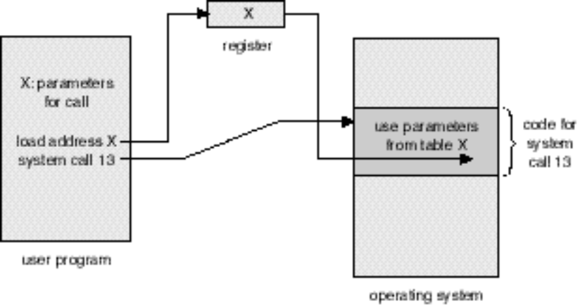
OPERATING SYSTEM STRUCTURES
System Calls
  A System Call is the main way a user program interacts with the Operating System.
Figure 3.1
Figure 2.8
Check out the Linux system command strace!

Slide 10

OPERATING SYSTEM STRUCTURES
System Calls
HOW A SYSTEM CALL WORKS
Obtain access to system space
Do parameter validation
System resource collection ( locks on structures )
Ask device/system for requested item
Suspend waiting for device
Interrupt makes this thread ready to run
Wrap-up
Return to user
There are 11 (or more) steps in making the system call
read (fd, buffer, nbytes)
Linux API

Slide 11

OPERATING SYSTEM STRUCTURES
System Calls
Example of Windows API
Consider the ReadFile() function in the
Win32 API—a function for reading from a file.
A description of the parameters passed to ReadFile()
  HANDLE file—the file to be read
  LPVOID buffer—a buffer where the data will be read into and written from
  DWORD bytesToRead—the number of bytes to be read into the buffer
  LPDWORD bytesRead—the number of bytes read during the last read
  LPOVERLAPPED ovl—indicates if overlapped I/O is being used

Slide 12

OPERATING SYSTEM STRUCTURES
System Calls
Two ways of passing data between programs.
Msg Passing
Shared Memory

Slide 13
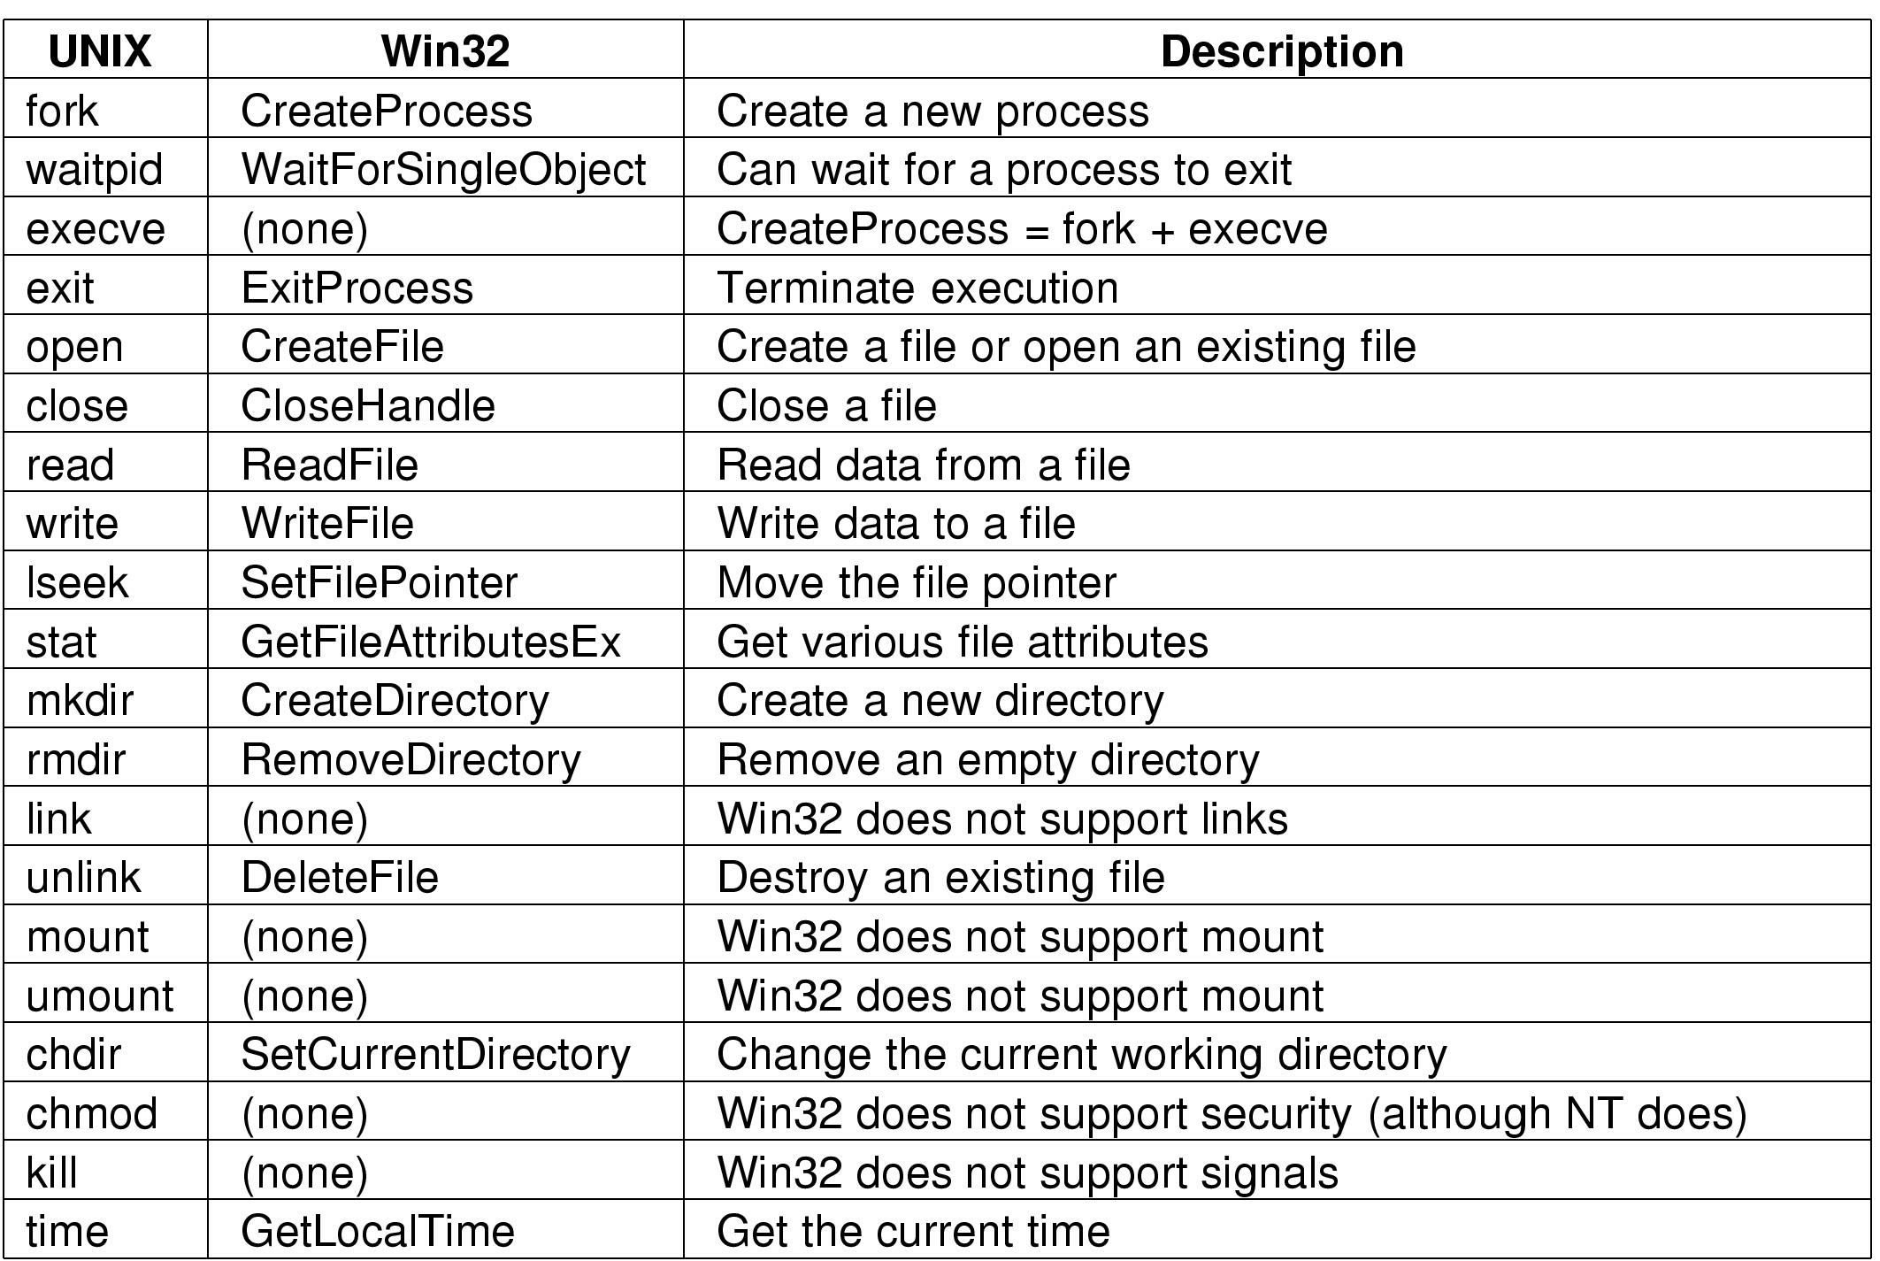
OPERATING SYSTEM STRUCTURES
System Calls
These are examples of various system calls.

Slide 14
OPERATING SYSTEM STRUCTURES
How An Operating System Is Put Together
A SIMPLE STRUCTURE:
Example of MS-DOS.
Application Programming
Note how all layers can touch the hardware. Bad News!!
Resident System Programming
MS-DOS Drivers
ROM - BIOS Device Drivers

Slide 15
OPERATING SYSTEM STRUCTURES
How An Operating System Is Put Together
A LAYERED STRUCTURE:
Example of Windows 2000.
System Services
Windows
MGR
& GDI
VM
Manager
Process
Manager
Security
Reference
Monitor
IO
Manager
Graphics
Device
Drivers
Windows 2000 Kernel
Hardware Abstraction Layer (HAL)

Slide 16

OPERATING SYSTEM STRUCTURES
How An Operating System Is Put Together
A LAYERED STRUCTURE:
Example of UNIX.

Slide 17
OPERATING SYSTEM STRUCTURES
Virtual Machine
In a Virtual Machine - each process "seems" to execute on its own processor with its own memory, devices, etc.
The resources of the physical machine are shared. Virtual devices are sliced out of the physical ones. Virtual disks are subsets of physical ones.
Useful for running different OS simultaneously on the same machine.
Protection is excellent, but no sharing possible.
Virtual privileged instructions are trapped.
Virtual User
Physical User
Virtual Machine
Monitor Mode
Physical Machine

Slide 18

OPERATING SYSTEM STRUCTURES
Virtual Machine

Slide 19
OPERATING SYSTEM STRUCTURES
Virtual Machine
Example of MS-DOS on top of Windows XP.
DOS APPLICATION
Physical User
BIOS DRIVERS
Windows XP
Physical Machine

Slide 20

OPERATING SYSTEM STRUCTURES
Virtual Machine
Example of Java Virtual Machine
The Java Virtual Machine allows Java code to be portable between various hardware and OS platforms.

Slide 21
OPERATING SYSTEM STRUCTURES
WRAPUP
We’ve completed our second overview of an Operating System – this at the level of a high flying plane.
We’ve looked at the basic building blocks of an operating system – processes, memory management, file systems, and seen how they all connect together.
Now we’ll get into the nitty-gritty, spending considerable time on each of these pieces.

